Slide 1
Objective
Educate Inventors
Explain Patent Prosecution Process
Provisional Application vs. Non-Provisional Application
It’s all about the CLAIMS
Costs associated with filing an application
Dealing with Patent Examiners (i.e. interviews)
Hiring a Patent Attorney/Agent?

Slide 2
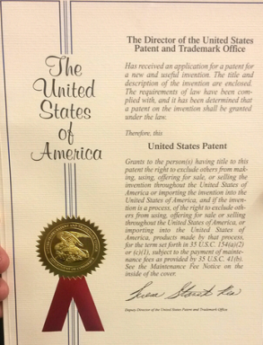
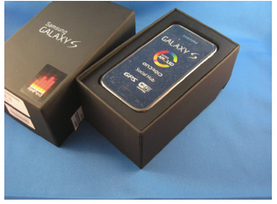
Identifying the type of IP
Copyright - Literary work, film, musical material
Patent - Design (ornamental look) vs. Utility (functionality)
Trade Secret- secret device or technique
Trademark/Service mark- Symbol, marking, establishes origin of good/services
Trade Dress - Visual appearance of a product or its packaging

Slide 3
Steps Before Filing
Write down your invention
Can you describe your invention in detail to a Person Having Ordinary Skill In The Art? (PHOSITA)
Can you illustrate all the elements in drawing (if applicable)?
Mere idea OR Inventive Concept
Conduct your own Prior Art Search
Online (Google/patents; USPTO website)
USPTO campus in Alexandria, VA (Madison Building)
Consult an Attorney/Agent
Patent Pro Bono Program (product of AIA) – provides free legal assistance to inventors of modest means who are interested in securing patents to protect their inventions.
Executive action by President Obama in Feb. 2014 to be effective in all 50 states.

Slide 4
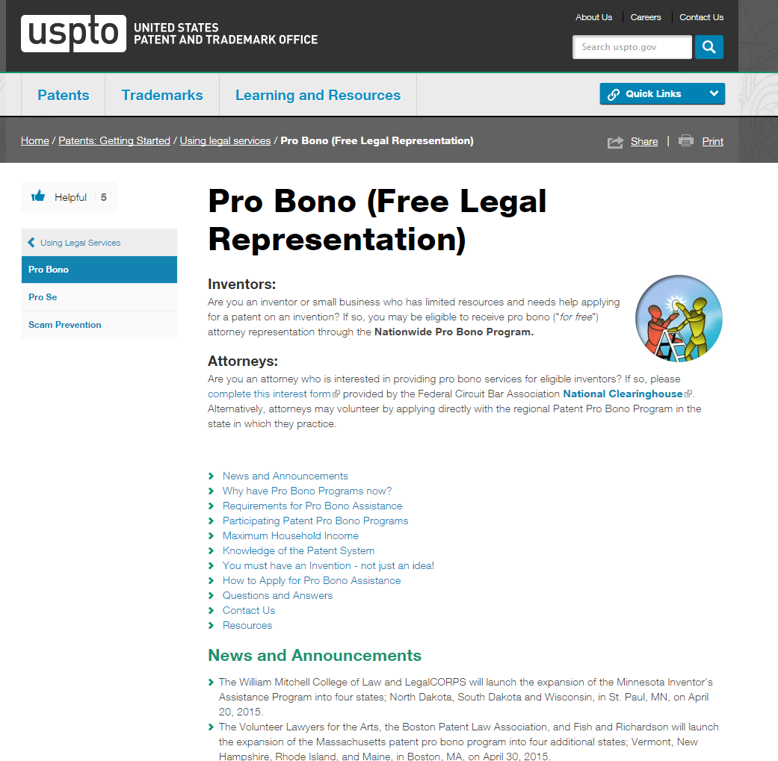
Patent Pro Bono Program
One of President Obama Administration’s seven Executive Actions for the USPTO to assist innovators by expanding pro bono program to cover all 50 states
http://www.uspto.gov/patents-getting-started/using-legal-services/pro-bono

Slide 5
How to Search Like an Examiner
Online research
Google patents;
USPTO website (main page: “search for patents”)
Classify your invention (more later)
Review Prior Art references
Pick up keywords used in that technology
i.e. focus on the problem being solved by each reference (found in background/summary/field of invention)
Look up synonyms
Truncate terms (using “$” or “*” signs)

Slide 6
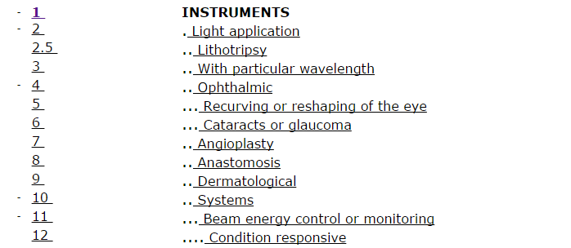
Classification System
CPC – Cooperative Patent Classification
USPC – United States Patent Classification

Slide 7
What do I Include in my application?
Contents of a Patent Application
Abstract
Background
Summary of the Invention
Brief Description of the Drawings (if any)
Drawings (if any)
Detailed Description
Throw in the kitchen sink
CLAIMS: name of the game is the claim (the most important part of the application – it defines your invention).
Potential licensing and/or infringement analysis depends on the claim language.
More Detail: see Chapter 600 of MPEP (Manual for Patent Examining Procedure)
Chapter 600: Parts, Form, and Content of Application

Slide 8
Provisional Application
Cost = $65 (micro entity); $130 (small entity)
Treat it like a regular application – include all the information (detailed specification, drawings, etc.). File it after you have finalized your inventive concept.
Don’t need an actual working prototype. But should be able to explain in detail, in writing, to a PHOSITA what your invention is about and how it works.
No Claims Required. Only specification & drawings (if any).
Pros
gives you a priority date;
have 1yr from this date to file non-provisional application;
can put “patent-pending” on your product
Cons
does not get examined, no one looks at it unless priority is being perfected;
cannot prevent anyone else from making, using or selling your disclosed invention (i.e. no rights granted).

Slide 9
Breakdown of Patent Prosecution (MPEP 700)
Case gets classified appropriately depending on the claimed invention, and accordingly docketed to the right Examiner
Examiner reviews the claimed invention, searches relevant art, and sends relevant correspondence to the Applicant
File complete non-provisional application (not provisional)
Types of Correspondences:
Restriction
Non-Final
Allowance (rare) (i.e. novel, non-obvious invention claimed)
Non-Final Rejection
Your claimed invention is not patentable (i.e. does not satisfy one or more of 35 USC 101, 102, 103, 112)
Schedule an Interview with the Examiner (more later). MPEP 713 (37 CFR 1.133)
Argue back OR amend claim language
Final Rejection
Exr. still doesn’t find your claimed invention novel/non-obvious
Options: AF, AFCP 2.0, Appeal, RCE
Note on Final Rejection – it represents close of prosecution. Should try to avoid it by opening channels of communication with Examiner after Non-Final Rejection

Slide 10
Interview (Meeting with the Examiner)
See MPEP 713: Interviews (37 CFR 1.133)
Have a candid conversation with the Examiner
But be quick, Examiners have very little time. Have 30mins to get your point across and come to an agreement on allowable subject matter.
Provide a thorough agenda, with proposed claim amendments, that helps the Examiner understand your rationale/position in advance; resulting in a productive interview
Bring in samples/prototypes (or videos) (very helpful)
Examiner’s hate inventor’s sob story
How novel their invention is annoying
Argue the prior art and your “claims” (i.e. claimed invention, not what is disclosed)
Help Examiners understand your invention by differentiating over the prior art
Provide the best prior art that you know (Information Disclosure Statement)

Slide 11
“Do’s/Don’ts”
Do’s:
Work with the Examiner
Provide them with best prior art (IDS)
Hold Interviews (i.e. meeting with the Examiner)
Be nice to them
Don’ts:
Rude, condescending
Ignore calls from the Examiner
Ignore recommendations from the Examiner (i.e. claim amendments)

Slide 12
Costs of a Patent Application (in US)
USPTO Fees (current fee schedule; small entity / micro entity)
Basic Filing Fee =
$140 / $70 (utility app.);
$90 / $45 (design)
Provisional App. Fee = $130 / $65
Search fee =
$ 300 / $150 (utility);
$60 / $ 30 (design)
Examination Fee = $ 360 / $180
Issue Fees (Patent Allowed) = $480 / $240
Continuing at 3.5yrs; 7.5yrs; 11.5yrs = $800 to $3700
Request for Continued Examination (RCE) = $600 / $300
2nd RCE = $850 / $425
Take Away =
Avoid filing RCE;
Try getting an allowance after Non-Final Rejection.
Source:
http://www.uspto.gov/learning-and-resources/fees-and-payment/uspto-fee-schedule

Slide 13
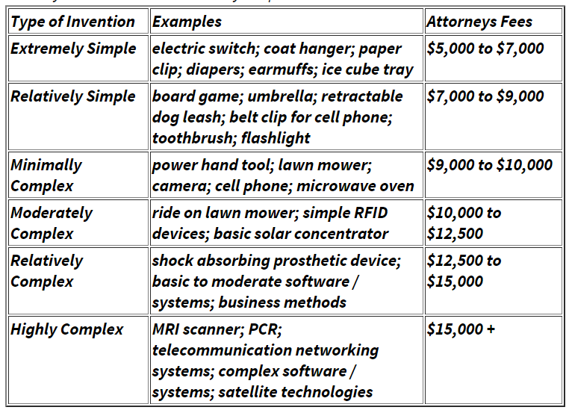
Attorney/Agent Costs
Source: IP Watchdog (2011)

Slide 14
Am I infringing on an existing product?
You can only infringe on a product if it is protected by a patent (i.e. USPTO has granted them rights to exclude others from making, selling, or using the claimed invention).
Can not infringe on a provisional application or a “patent pending” product – no rights granted.
Always consult an Intellectual Property Attorney before you further develop your invention.

Slide 15
Do I really need a (patent) attorney?
Highly Recommended!!
Even if you have read/understand the MPEP (Manual for Patent Examining Professionals), seek a professional.
Things to look for in an attorney/agent?
Work experience (preparation/prosecution), educational background, work history.
Not all Patent / IP attorneys do patent prosecution work. Check their work history or client base.
They must have USPTO Registration Number if representing you before USPTO in Patent matters (i.e. patent prosecution and post-grant review matters: IPR, CBP, PTAB).
Charges: hourly rate vs. flat fee
Patent Attorney/Agent:
Patent Attorney = more expensive, but can represent in more than just patent matters, and beyond USPTO proceedings.
Patent Agent = less expensive, but limited to representation before USPTO (only Patent side, not Trademark).

Slide 16
Summary
Conduct own preliminary prior art search
Patent Pro Bono Program (free legal assistance for inventors)
Patent vs. Publication/Public disclosure
Provisional App. – no rights granted
Contents
USPTO Costs of filing
Costs of hiring an attorney/agent
Holding interviews with the Examiner – provide thorough agenda

Slide 17
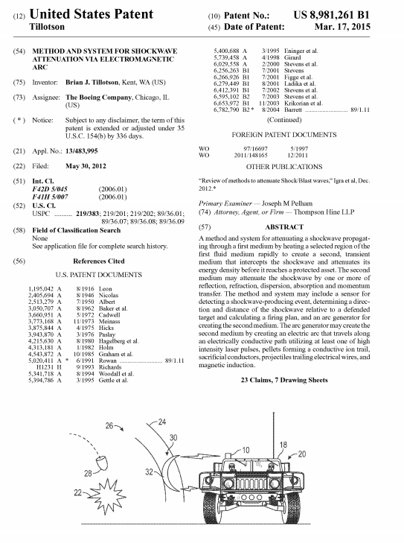
In the News
“May the force-field be with you: Boeing granted patent for 'shock wave attenuation’”; Source: CNN.com

